Slide 1
DATA SCIENCE BOOTCAMP
MARKET BASKET ANALYSIS
March, 2018

Slide 2






Market Basket Analysis
Introduction
CONCEPT
A data mining technique that is used to identify patterns of co-occurrence among objects
Ascertain items likely to be purchased together
WHY IS IT IMPORTANT TO UNDERSTAND PRODUCT AFFINITIES?
Plan for promotions
Reducing price on one item may cause a spike in the sales of related/high-affinity items
Store Layout
Items that go along should be placed next to each other to help consumers notice them
Maintain inventory
Evaluate which items would fall short, and maintain stocks in optimal quantity

Slide 3
Market Basket Analysis
Apriori Algorithm: Frequent Item Sets
CONCEPT
Classic algorithm for mining frequent item sets and relevant association rules
Devised to operate on a dataset containing a lot of transactions, for instance items bought in a departmental store
Transaction ID | Items bought by the customers
1 | A, B, C
2 | A, C
3 | A, D
4 | B, E, F
Items | Support / Freq
A | 3
B | 2
C | 2
D | 1
E | 1
F | 1
Minimum Support Threshold = 50%
Items | Support / Freq
A | 3
B | 2
C | 2
Items / Combinations
A, B
A, C
B, C
Items | Support / Freq
A, B | 1
A, C | 2
B, C | 1

Slide 4
Market Basket Analysis
Apriori Algorithm: Pattern Identification
ASSOCIATION RULES
Created by analyzing data for frequent if/then patterns
Discovers the probability of co-occurrence of items in a collection
If X then Y
60% of those who buy books online also buy music online
50% of those who have high blood pressure and are overweight have high cholesterol
Even though MBA conjures up pictures of shopping carts and supermarket shoppers, it could be applied to other areas as well
Items purchased on credit/debit card(s) could give insight into other products a customer is likely to purchase
Telecommunication/calling patterns help determine how to structure product bundles which maximize revenue

Slide 5
Market Basket Analysis
Measurement Areas
ASSOCIATION RULE
X -> Y
Here X is called the antecedent, while Y is called the consequent
KEY METRICS TO EVALUATE AN ASSOCIATION RULE
Support = n(X U Y) / N
Confidence = n(X U Y) / n(X)
Expected Confidence = n(Y) / N
Lift = Confidence / Expected Confidence
(Fraction of transactions that contain both X and Y)
(How often Y appears in transactions that contain X)
(Support of the Consequent in the entire set of transactions)
(Value >1 indicates that X & Y appear more often together than expected)

Slide 6
Market Basket Analysis
Example
Transaction ID | Items bought by the customers
1 | Apple, Banana, Cherry, Durian
2 | Apple, Durian
3 | Banana, Durian
4 | Durian, Banana, Cherry
5 | Banana, Durian
6 | Apple, Banana
7 | Apple, Cherry, Durian
Apple -> Banana
Support = n(X U Y) / N = 2/7 = 28.6%
Confidence = n(X U Y) / n(X) = 2/4 = 50%
Expected Confidence = n(Y) / N = 5/7 = 71.4%
Lift = Confidence / Expected Confidence = 50%/71.4% = 0.70
Lift <1 indicates Apple and Banana appear less often together than expected

Slide 7
Market Basket Analysis
Pruning of Association Rules
Association Rule | Support | Confidence | Lift
{Class – 2nd, Age – Child} -> {Survived = Yes} | 0.0109 | 0.98 | 3.095
{Class – 2nd, Age – Child, Sex - Female} -> {Survived = Yes} | 0.0059 | 0.98 | 3.095
Rule 2 does not provide extra knowledge in addition to Rule 1, since Rule 1 tells us that all 2nd class children survived
If the latter rule has the same or lower lift, it is considered to be redundant
To constrain the potential number of rules, one could screen out those that do not meet the minimum benchmarks. For instance, if there is a dataset of 2000 transactions, one can set a 10% support threshold. This would filter out item sets that have less than 200 transactions. Similar cut-off could be kept for Confidence levels as well.

Slide 8
Market Basket Analysis
R Code
#Market Basket Analysis
library(arules)
library(arulesViz)
library(xlsx)
#Change the path
Data=read.transactions("C:\\Users\\A498396\\Documents\\Market Basket Analysis (MBA)\\Transactional Data.csv",format="single",sep=",",cols=c(1,2))
summary(Data)
inspect(Data[1:5])
itemFrequencyPlot(Data,topN=20,type="absolute")
Rules <- apriori(Data, parameter = list(supp = 0.007, conf = 0.01,maxlen = 2))
inspect(Rules[1:5])
summary(Rules)
Rules <- sort(Rules, by="confidence", decreasing=TRUE)
inspect(Rules[1:5])
Results=as(Rules, "data.frame")
#Change the path
write.xlsx(Results,"C:\\Users\\A498396\\Documents\\Market Basket Analysis (MBA)\\Results from R.xlsx")

Slide 9
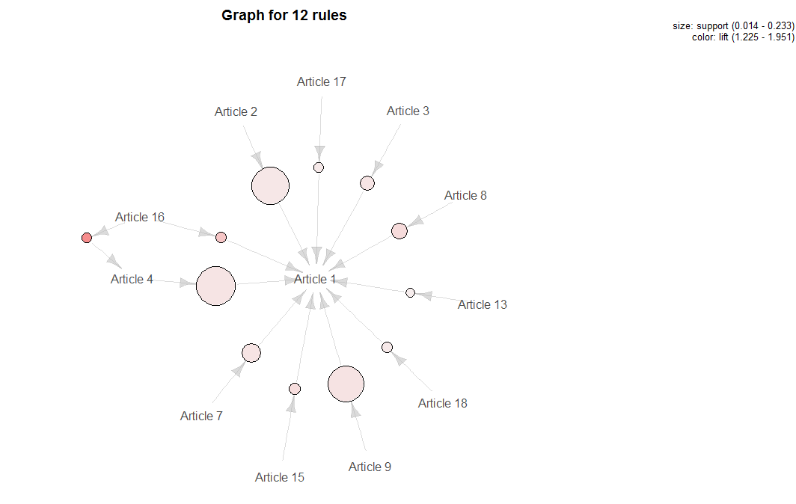
Market Basket Analysis
Graph

